Slide 1

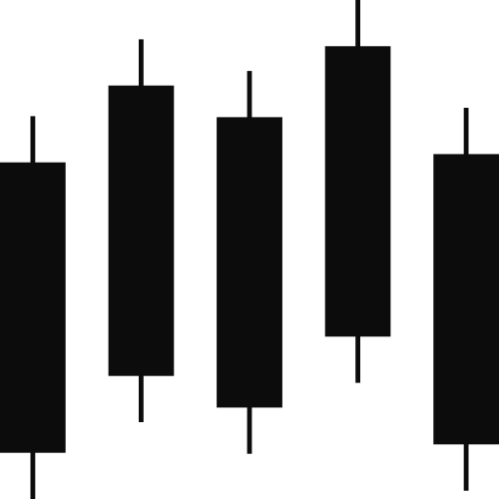


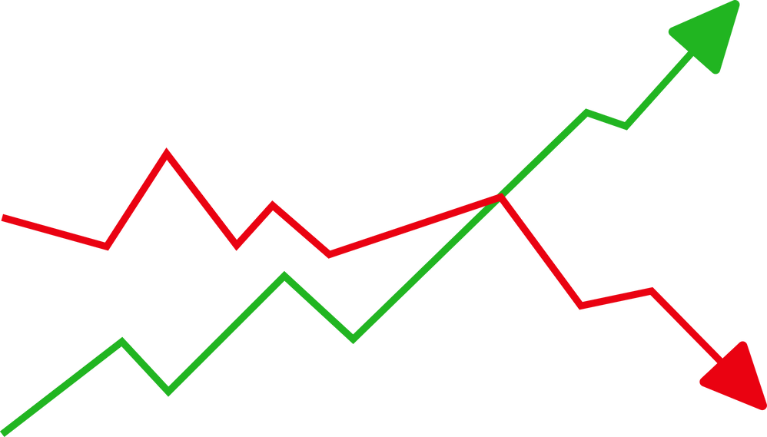

FinSight: A Python Package for Stock Market Analysis
NAME: KARAN NADAR
CWID: 20034735
FE 520 FINAL PROJECT
Notes:
1

Slide 2







Introduction and Project Objective
Project Overview
FinSight is an integrated Python package for effective stock market data analysis.
Target Audience
Targets quantitative analysts, retail investors, and financial data science students who need a lightweight, code-first solution.
Problem Solved
Eliminates the friction of manually downloading CSVs or calculating indicators in Excel, providing a programmatic way to visualize stock performance out of the box.
Core Functions
Automates three processes: fetching reliable historical data, calculating key technical indicators like Moving Averages, and generating dynamic charting for investment decisions.
Notes:
2

Slide 3


Modular Architecture and Assignment Compliance
FinSight's architecture is built on a modular design, ensuring clarity, maintainability, and direct compliance with project requirements.
Financial Analytics
Process and analyze data to generate actionable insights.
Data Acquisition
Visualization
Present insights through dashboards for decision making.
Collect and ingest raw financial data from sources.
01
02
03
Modularity Requirement
Separation of Concerns (SoC)
Module Breakdown
The project is structured into three distinct modules, fulfilling the assignment requirement for 'at least three main capabilities'.
This design (e.g., data_loader.py,analytics.py) prevents cascading failures; changes in one module won't break others.
  Data Acquisition: Utilizes yfinance for data collection with robust error handling.
  Financial Analytics: Calculates metrics like SMA and Volatility in a vectorized format.
  Visualization: Generates high-quality matplotlib graphs to display buy/sell signals effectively.
Notes:
3

Slide 4



Technical Design Philosophy
My approach integrates robust programming principles with strategic tool selection, ensuring efficiency, maintainability, and future adaptability for FinSight.
Object-Oriented Programming (OOP)
Enhanced Scalability
Strategic Library Choices
The solution leverages an OOP-based approach with dedicated classes (e.g., DataLoader, StockAnalyser) that enable State Encapsulation. This strategy holds the main data structure (the DataFrame) as an object attribute, significantly reducing memory consumption and complexity by eliminating the need to pass large data objects repeatedly.
FinSight's modular OOP structure inherently enhances scalability. This design makes it straightforward to integrate new functionalities, such as additional technical indicators or alternative data sources, without requiring a comprehensive remodeling of the entire application.
We selected libraries for maximum effectiveness in financial analysis: yfinance for reliable and lightweight data acquisition, pandas and numpy for efficient time-series handling and Vectorized Calculations, and matplotlib for the granular control necessary for complex multi-series and dual-axis financial charts.
Notes:
4

Slide 5
Deep Dive: Financial Analytics and Vectorization
FinSight employs highly optimized vectorized computations for financial analytics, ensuring speed and precision crucial for real-time market insights.
1
2
Vectorized Efficiency
SMA Calculation
Prioritizing computation speed, FinSight utilizes vectorized operations in panda and numpy to bypass slow Python for-loops on large datasets, significantly enhancing performance.
The Simple Moving Average (SMA) is efficiently computed using pandas.Series.rolling().mean(), allowing for rapid calculation across entire data columns, e.g., data['Close'].rolling(window=50.mean).
3
4
Vectorization Advantage
Volatility Metric
This vectorized approach executes calculations via optimized C code, delivering performance vastly superior to traditional Python for-loops, especially with extensive historical data.
Volatility is precisely determined using numpy.std() on daily stock returns derived from .pct_change(), guaranteeing both accuracy and computational efficiency for statistical metrics.
Notes:
5

Slide 6

System Robustness and Defensive Programming
FinSight is engineered with defensive programming principles to prevent "brittle" failures and implement graceful degradation, ensuring stability and a smooth user experience even when unexpected issues arise.
Invalid Tickers
Network Instability
Date Format Validity
Problem: The yfinance library can silently return an empty DataFrame for invalid ticker symbols. Solution: Immediate validation checks data.empty. User Feedback: "Ticker not found: Please check your symbol."
Problem: API calls risk failure due to connectivity loss or rate-limiting (e.g., HTTP 429).
Solution: A try/except block manages exceptions like ConnectionError.
User Feedback: "Network Error: Unable to connect to the finance server."
Problem: Ambiguous or invalid date formats (e.g., "yesterday") can cause errors.
Solution: The application attempts conversion to a standard date format, catching ValueError. User Feedback: "Invalid Date Format Detected. Please Enter in YYYY-MM-DD Format."
Notes:
6

Slide 7
Visualization Features and Quality
FinSight's visualization module is engineered for clarity and precision, offering robust tools for interpreting complex market data through intuitive charts.
1
2
3
4
Matplotlib
Object-Oriented API
Multi-Series Plotting
Handling Data Gaps
Enhanced Usability
I utilized the matplotlib object-oriented API (fig, ax= plt.subplots()) to gain granular control over plot elements, titles, and axes, ensuring highly customized and professional outputs.
The module implements multi-series plots to display the raw closing price (solid line) alongside calculated indicators (dashed lines in distinct colors), enabling traders to easily spot potential trend reversal signals.
A technical challenge, temporal discontinues (e.g., weekends), can create misleading visual artifacts. Our solution uses Pandas functionality to re-index data, focusing on discrete trading periods to avoid flat lines.
All charts include essential features such as Legends for clear identification, Gridlines for easy price level reading, and automatic Date Formatting on the x-axis to prevent clutter.
Notes:
7

Slide 8
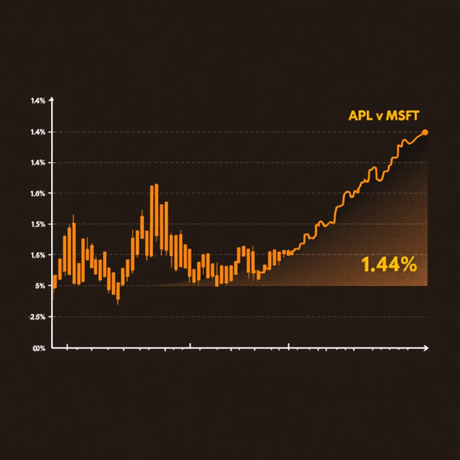
Use Cases and Validation
FinSight's practical applications showcase its analytical power and robust error handling, providing immediate insights and a stable user experience.
Key Use Cases
1.44%
1.26%
AAPL Volatility
MSFT Volatility
Daily volatility for Apple, indicating its price fluctuation for a specified period.
Daily volatility for Microsoft, demonstrating comparative risk assessment.
Trend Analysis: We analyzed TSLA by plotting both the 50-day and 200-day SMAs, allowing active traders to spot key trend changes (e.g., Golden Cross/Death Cross signals).
Rigorous Validation
The program was rigorously validated. For example, Test Case 2 confirmed that an invalid ticker ('INVALID123') successfully resulted in the user-friendly message "Ticker not found: Please check your symbol," rather than a crash.
Project Summary
  Successfully achieved the automation of data acquisition.
  Enhanced resilience through defensive programming.
  Provided immediate data insight via visualization.
Notes:
8

Slide 9




Conclusion and Future Recommendations
The FinSight project successfully delivered a complete, reliable, and modular financial time-series analysis framework, effectively applying Python techniques for API management, dataframes, and robust error handling.
User Experience
Transition from the current CLI to a GUI (e.g., Streamlit, Tkinter) to make FinSight more accessible for non-technical users.
Analytical Depth
Integrate specialized libraries like TA-Lib to expand analytical capabilities with a wider range of technical indicators beyond SMA, such as RSI.
Real-Time Capabilities
Implement WebSockets or frequent API polling for live data analysis, transforming FinSight into a high-performing real-time trading assistant.
Notes:
9

Slide 10


Thank You!
Notes:
10

